Slide 1

WEB PHISHING DETECTION
TECHNICAL ARCHITECTURE

Slide 2
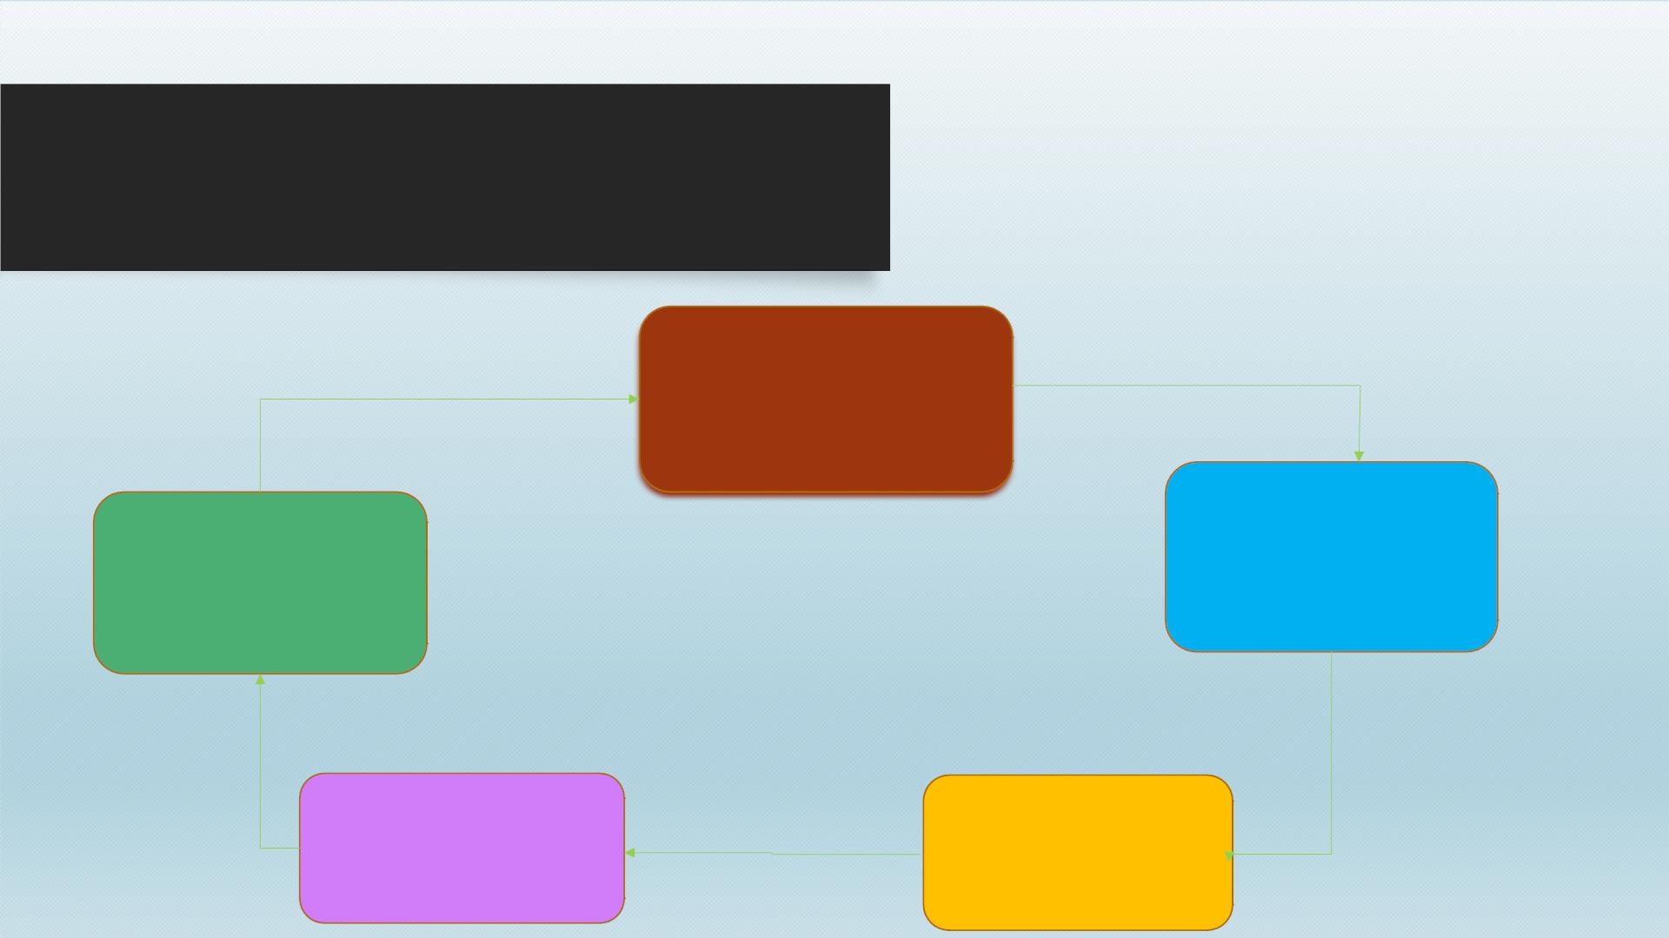
PHISHING
Victims click on link in
email believing it is
legitimate. They enter
personal information.
Fraudsters compile
the stolen data and
sell it online or use
it themselves.
Send out thousands
of phishing emails
with link to fake
websites.
Build Fake site
Fraudsters

Slide 3
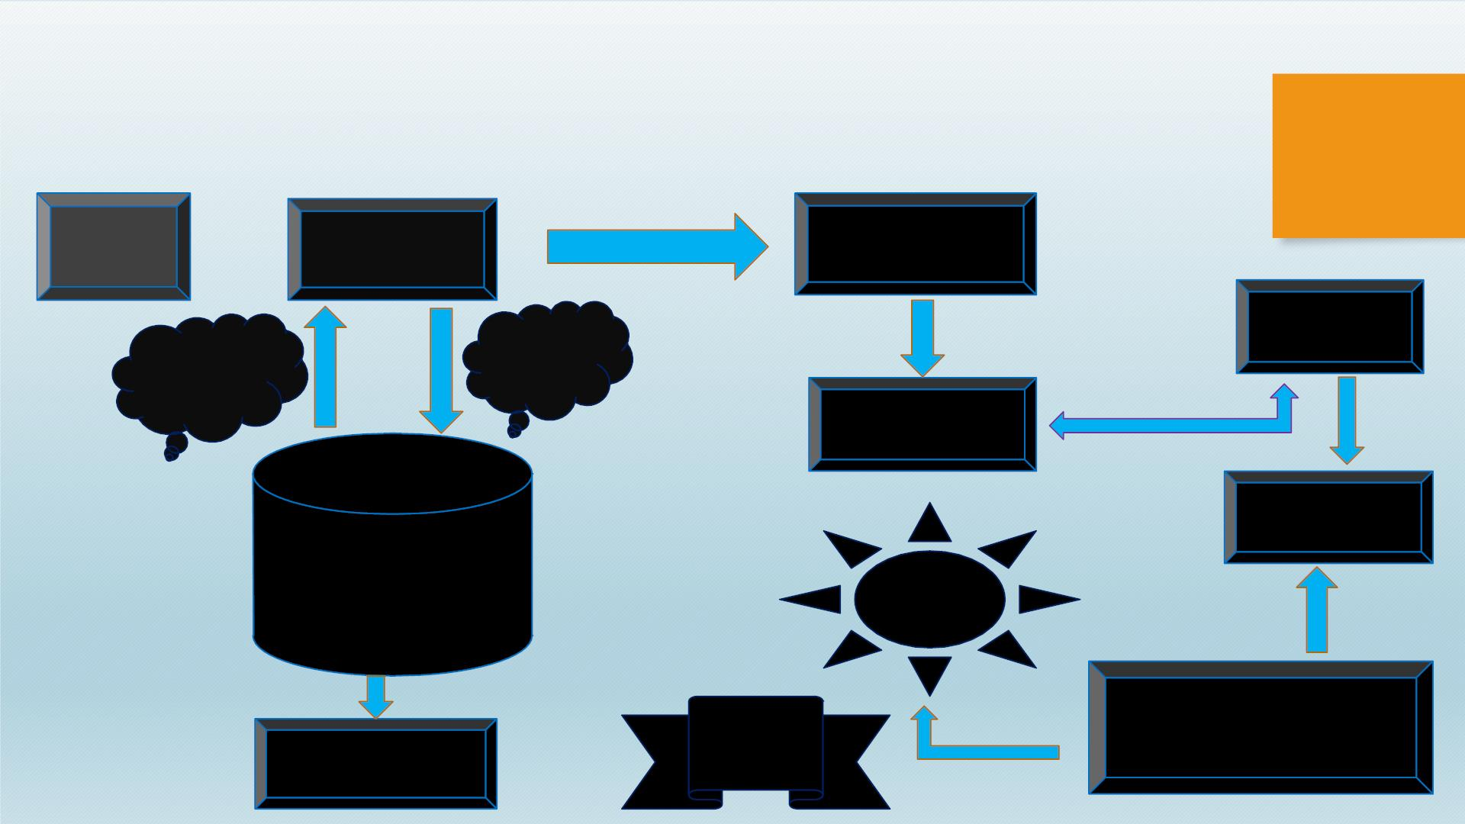
TECHNICAL ARCHITECURE
USER
LOGIN
INBOX
Login
succes
sfully
CHECK
MAIL
Check
for login
details
RECEIVE
MAIL
LOGOUT
DATABASE
CONSISTING OF USER
DETAILS
LINK
GUAR
D
Detect
phish
mail
MAIL IS MARKES AS
PHISH MAIL BY GIVING
WARNING TO THE USER
Relogin or
Signup

Slide 4

TEAM ID :PNT2022TMID19765
• TEAM LEADER : NANDEESWARAN S
• TEAM MEMBERS : NALANKUMAR GM
MOHANPRASANTH D
SOWNDHAR P

